Slide 1

Security for
Web Applications
Web Vulnerabilities: HTML & DOM

Slide 2
References
Securing Frame Communication in Browsers. Adam Barth, Collin Jackson, and John C. Mitchell
http://seclab.stanford.edu/websec/frames/post-message.pdf
Same Origin Policy
http://code.google.com/p/browsersec/wiki/Part2#Same-origin_policy
Cross Site Request Forgery
http://users.ece.cmu.edu/~dbrumley/courses/18732-f09/2009-10-14-csrf-cmu-ece-18732.pdf
XSS Tutorial
http://hackertarget.com/xss-tutorial/

Slide 3
Web Security: Overview

Slide 4
Web Applications
Software as a (Web-based) service:
Online banking, shopping, government, etc.
Cloud computing.
Languages for web applications:
A mixture of HTML, PHP, Java, Perl, Python, C, ASP.
Security is rarely the main concern:
Poorly written scripts with inadequate input validation
Sensitive data stored in world-readable files

Slide 5
Typical Web Application Design
Takes input from Web users (via Web server).
Interacts with back-end databases and third parties.
Prepares and outputs results for users (via Web server)
Dynamically generated HTML pages
Content from many different sources/registered users:
Blogs, social networks, photo-sharing websites…

Slide 6
Browser: Execution
Interface between user and server.
Loads content (output from web server).
Renders:
Processes HTML and Scripts to display the page.
May involve images, subframes, etc.
Responds to events:
User actions:
OnClick, OnMouseover, OnKeyPress, OnMouseDown
Rendering:
OnLoad, OnUnLoad
Timing:
setTimeout, clearTimeout

Slide 7
HTML/Script Example
<html>
…
<p> The script on this page adds two numbers </p>
<script>
var num1, num2, sum
num1 = prompt("Enter first number")
num2 = prompt("Enter second number")
sum = parseInt(num1) + parseInt(num2)
alert("Sum = " + sum)
</script>
…
</html>

Slide 8
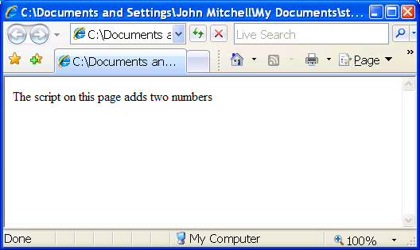
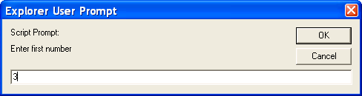
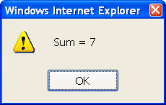
Try on: http://www.w3schools.com/htmldom/tryit.asp?filename=try_methods

Slide 9
Event-Driven Script
<script type="text/javascript">
function whichButton(event) {
if (event.which==1) alert("You clicked the left mouse button!")
else alert("You clicked the right mouse button!")
}
</script>
…
<body OnMouseDown="whichButton(event)">
…
</body>

Slide 10
JavaScript into HTML pages
Embedded in HTML page as SCRIPT:
directly inside: <script> alert("Hello World!") </script>
Linked file as src attribute:
<script type="text/JavaScript" src=“functions.js"></script>
Event handler attribute:
<a href=http://www.yahoo.com OnMouseOver=alert('hi');>
Pseudo-URL referenced by a link
<a href=“JavaScript: alert(‘You clicked’);”>Click me</a>

Slide 11

HTML Structure: DOM
Document Object Model (DOM):
Document nodes: elements, attributes, texts/comments
Elements defined as objects (accessed with JavaScript, etc.)
Via method: action like add, modify an object
getElementById(), createElement(), getAttribute()
Via property: states like name, content
x.firstChild.nodeValue, .innerHTML

Slide 12
DOM: Example
Sample HTML
<ul id="t1">
<li> Item 1 </li>
</ul>
Attribute: id=“t1”
Element <ul>
Element <li>
Text: Item 1

Slide 13
Examples: Script Read Access
1. document.getElementById('t1').nodeName
2. document.getElementById('t1').nodeValue
3. document.getElementById(‘l1').nodeName
4. document.getElementById(‘l1').firstChild.nodeName
5. document.getElementById(‘l1').firstChild.nodeValue
Sample HTML
<ul id=“t1”>
<li id=“l1”> Item 1 </li>
</ul>
Example | Returns
1 | “ul”
2 | “null”
3 | “li”
4 | “text” → (why?)
5 | “Item 1”

Slide 14
Examples: Script Write Access
1. var list = document.getElementById('t1')
2. var newitem = document.createElement('li')
3. var newtext = document.createTextNode(“Item 2")
4. list.appendChild(newitem)
5. newitem.appendChild(newtext)
Sample HTML
<ul id="t1">
<li> Item 1 </li>
</ul>
Example | Task
1 | Sets list = the “ul” element
2 | Creates newitem = new “li” element
3 | Creates newtext = new “text” node
4 | Puts newitem at the end of list
5 | Puts newtext in newitem

Slide 15
Script: Stealing Browser History
Script cannot directly access browsing history but …
If you have visited a website, the link color is different
Script can include an invisible link and check the color
Check to see if user visited competitors
var link= document.getElementById("myLink");
alert(window.getComputedStyle(link, null).getPropertyValue("color"))
function getLinkColor(url) {
var a = document.createElement('a');
a.href = a.textContent = url;
document.body.appendChild(a);
return document.defaultView.getComputedStyle(a, null).color;
}

Slide 16
Remote Script Code is Risky
Integrity
Compromise your machine
Install malware rootkit
Transact on your accounts
Confidentiality
Read your information
Steal passwords
Read your email

Slide 17
Security Solution
SandBox:
Limited access to OS, network, and browser data.
Isolate sites in different security contexts.
Browser manages resources, like an OS.
Same Origin Policy:
Can only read properties of documents and windows from the same server, protocol, and port
What if same server BUT unrelated websites/scripts?
Does it matter where script refers to the same origin or NOT?!
What if the server is vulnerable?
Privileges to signed scripts:
Universal read, write, sendMail

Slide 18
Same-Origin Policy (SOP)

Slide 19
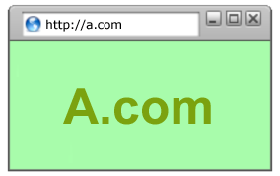
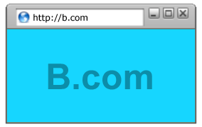
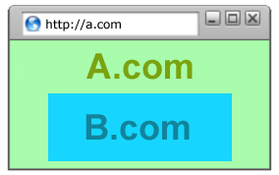
SOP: Goals
Safe to visit an evil web site
Safe to visit two pages at the same time
Allow safe delegation

Slide 20
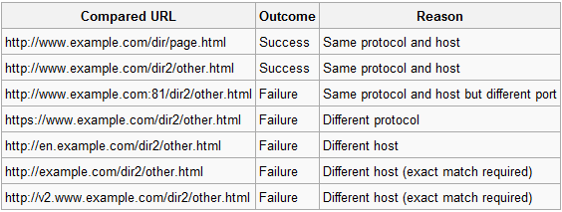
SOP: General Access
Can only read properties of documents and windows from the same server, protocol, and port
Prevent Cross-site issues!
Access from http://www.example.com/dir/test.html

Slide 21
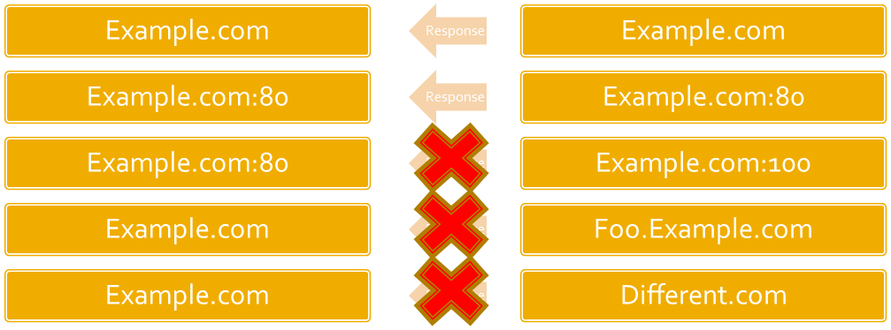
SOP: Get & Post Requests
Get/Post request can be made from one domain to another.
Get/Post response can only be read under these conditions:
If the ports match on both sites.
If the domain + subdomain match on both sites.

Slide 22
Post/Get Exception
Two different subdomains (different origin) are under the same domain & one is performing domain lowering (via document.domain)
Example:
Clock.live.com vs. Vulnerable.live.com
Clock.live.com sets document.domain to live.com.
Vulnerable.live.com is corrupted by attacker, s/he can set domain to live.com and access clock.live.com!
Threat:
All eggs in one basket (*.google.com or *.live.com).
Cross-subdomain communication.
Cross-Site Request Forgery

Slide 23
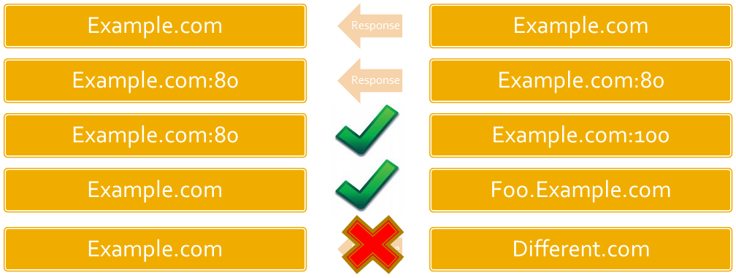
SOP: Cookies
Grant access if:
The domain is the same (Limited subdomain check)
Foo.bar.com → bar.com
bar.com → foo.bar.com
Does not respect port numbers!
Does not respect scheme/protocol:
Unless you opt in to secure attribute

Slide 24
Risks
Foo.bar.com can steal/poison cookie on bar.com.
Foo.bar.com:1111 can steal/poison cookie on Foo.bar.com:2222.
With regards to cookie and subdomains and ports are of limited security boundary.

Slide 25
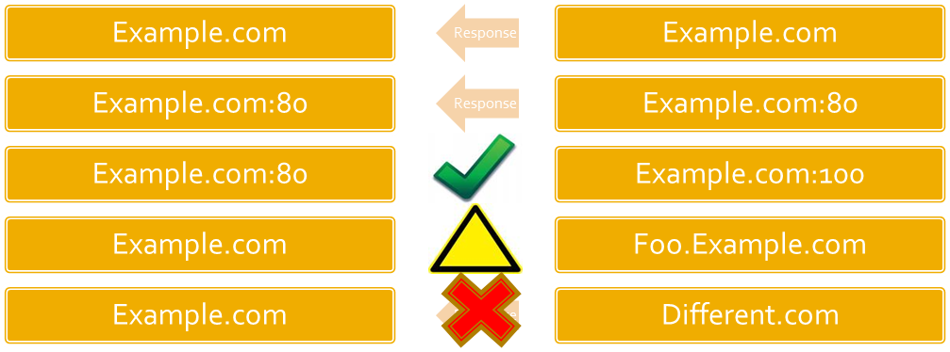
SOP: IE
Does not use ports during origin calculation.
You can read/write/script between:
Bar.com:80 and Bar.com:1234

Slide 26
Risks
Host multiple web apps on different ports
Should be avoided when possible
Ports are not a security boundary for IE
Host web apps on separate domains

Slide 27
Network tools: NMAP and Wireshark

Slide 28
NMAP & Wireshark
Powerful open-source tools for:
Network analyzing
Security check
Education
NMAP:
Finds other alive systems and their open services/ports over the network.
Wireshark:
Analyzes accessible interface packets: headers, statistics, etc.

Slide 29
NMAP

Slide 30
What is NMAP?
Network Mapper: Security scanner of hosts & services on a computer network.
Written by Gordon Lyon (AKA Fyodor Vaskovich).
Runs on different platforms.
Services:
Host accessibility
Host OS
Open ports
Service names & versions
Estimated uptime
Device type
Presence of a firewall
Scriptable interaction

Slide 31
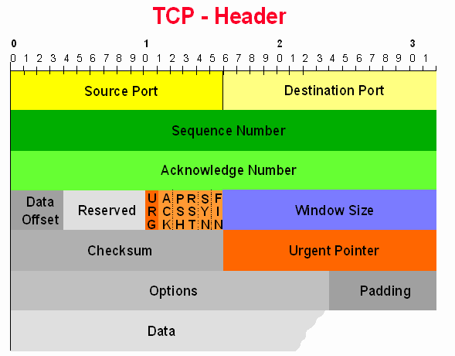
NMAP: Synopsis
Synopsis
nmap [ <Scan Type> ...] [ <Options> ] {<target specification>}
Scanning Protocols:
TCP
UDP
ICMP
Ping:
ICMP ping
TCP ping

Slide 32
NMAP: Basic Port Scanning
UDP scan: -sU
Sends 0-byte UDP packets to each port.
ICMP Port Unreachable → closed
Nothing → open
Slow due to ICMP frequency control [2¹⁶!!] (but good on Windows ☺ )
Useful for UDP services:
SNMP, NFS, the Back Orifice Trojan backdoor
TCP connect scan: -sT
Begins TCP connection with SYN=1 on each port.
Follows SYN – ACK/SYN – SYN handshake.
Finds open/closed/filtered ports: (handshake / RST / ----)
Easy to detect by firewall or IDS.
SYN scan: -sS
Follows SYN – ACK/SYN – RST to drop connection.
Typically does not appear in log files.

Slide 33
NMAP: Advanced Port Scanning
Modern firewall and IDS can detect SYN (-sS) scan…
There are other scan types to help.
FIN scan: -sF
Sends packet with FIN=1.
Notes whether or not the connection succeeded.
XmassTree scan: -sX
Sends packet with FIN=1, URG=1, PSH=1.
Null scan: -sN
Sends packet no flags set.

Slide 34
NMAP: Host/IP Scanning
Ping scan: -sP
First ICMP; if not responded, SYN or ACK.
Using -P0 option removes ICMP ping.
IP protocols scan: -sO
Sends a raw IP packet to each protocol.
ICMP Port Unreachable → not in use.
Nothing → in use.
ICMP frequency problem, but OK! [2⁸]

Slide 35
NMPA: Other Scan Types
Idle Scan: -sI
Needs IP spoofing a Zombie!
Gets information from the Zombie’s IPID.
ACK Scan: -sA
Sends ACK packet.
RST response → unfiltered OR Nothing → filtered.
If there is a firewall: can tell if stateless/stateful.
Usually used with other scan types
Window scan: -sW
Sometimes infer open ports too!
RPC Scan: -sR
Checks if a port is remote procedure call (RPC) service.
List Scan: -sL
Just a list of IPs and DNS names.

Slide 36
NMAP: Basic Options
Verbosity: -v
Version detection: -sV
Service running on a port: product name & version.
OS detection: -O
Gets OS information of the target.
OS & Version detection: -A

Slide 37
NMAP: Other Options
Timing:
From -T0 (paranoid > 5 mins) to -T5 (Insane ~ 0)
Decoy: -D
Output logging:
-oN (human), -oX (XML), -oG (Grepable)
Scan from a file: -iL
IPV6: -6
Stop & resume: Cntrl+C & -resume
Fast scan: -F
nmap_services ports
Setting TTL: -ttl

Slide 38
NMAP: A few examples
Ping scan of IPs: which hosts are alive?
nmap -sP 192.168.181.0/24
(specific range) nmap -sP 192.168.181.90-100
Scan ports of an IP: which ports are open?
nmap -sS 192.168.181.102
Find OS of an IP: what is its OS?
nmap -O 192.168.181.102

Slide 39
Wireshark

Slide 40
What is Wireshark?
Open-source packet analyzer with GUI:
For network troubleshooting & analysis.
The command-line version is called tshark.
Written by Gerald Combs: originally named Ethereal.
Runs on different platforms.
Features:
Data capturing: wire / network / USB traffic / file packets.
Ethernet, IEEE 802.11, PPP, and loopback.
Display filter.
Allowing for Plugins.
VoIP calls detection or even playing.

Slide 41
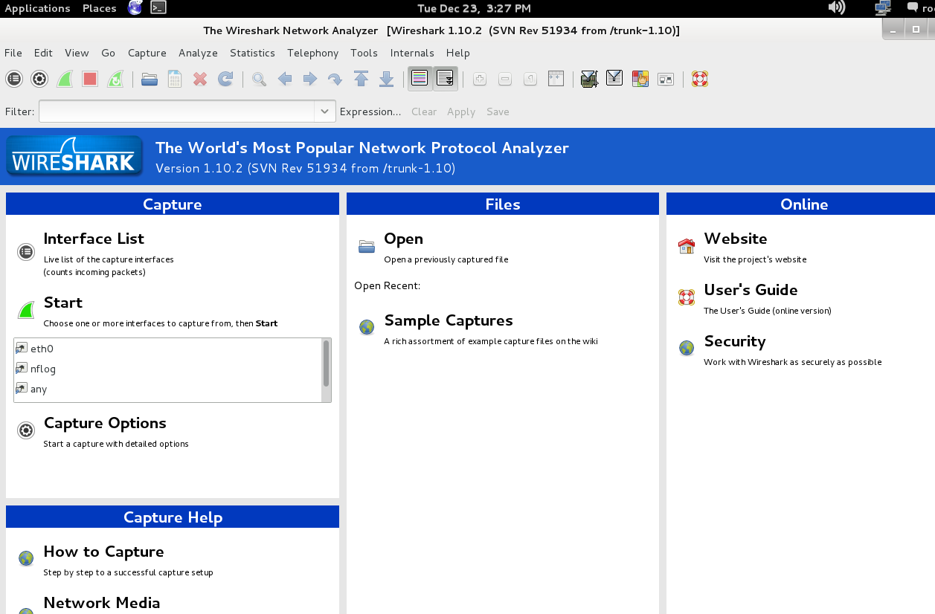
Wireshark: Graphical User Interface

Slide 42

Wireshark: Command Menus
File:
Save & load captured packet data.
Edit:
Find a packet, time reference or mark one or more packets,
View:
Display of the captured data: e.g., colors, font, expanding and collapsing trees.
Go:
Go to a specific packet.
Capture:
Begin packet capture.
Analyze:
Manipulate display filters, dissection of protocols, configure decodes.
Statistics:
Summary of captured packets, protocol hierarchy statistics, etc.

Slide 43
Wireshark: Network Data Capture
Notes:
Root / Administrator privileges.
Right network interface to capture packet data from.
Capture right place in the network to see the traffic.
Four possible ways:
Using the “Capture Interfaces” dialog box.
Using the “Capture Options” dialog box.
Immediately using “Capture Start” item (if options are set).
Command line:
wireshark -i eth0 -k

Slide 44
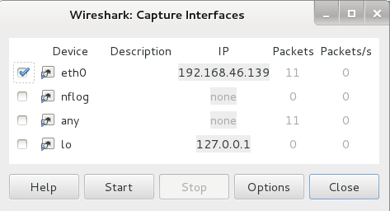
Wireshark: Capture Interface
Capture menu → Interfaces
Possible to capture packets from multiple interfaces.
May Consume a lot of resource!

Slide 45
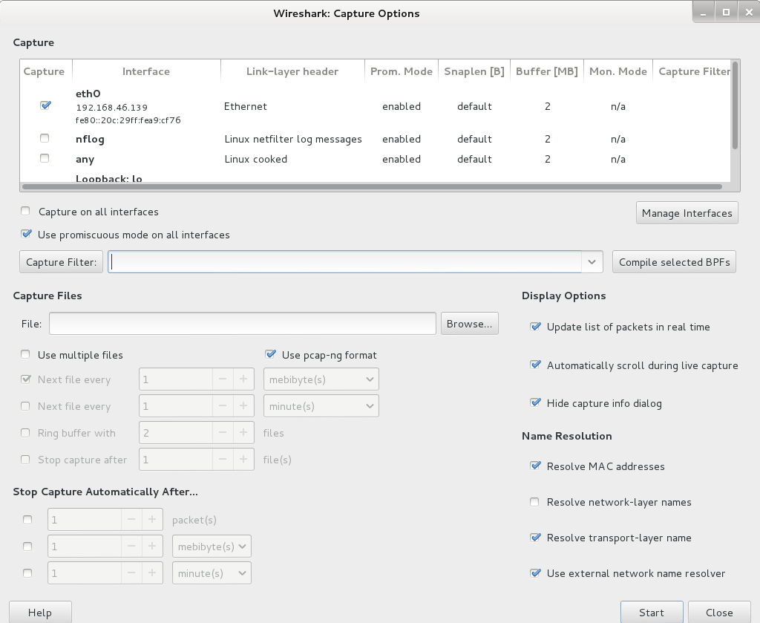
Wireshark: Capture Options

Slide 46
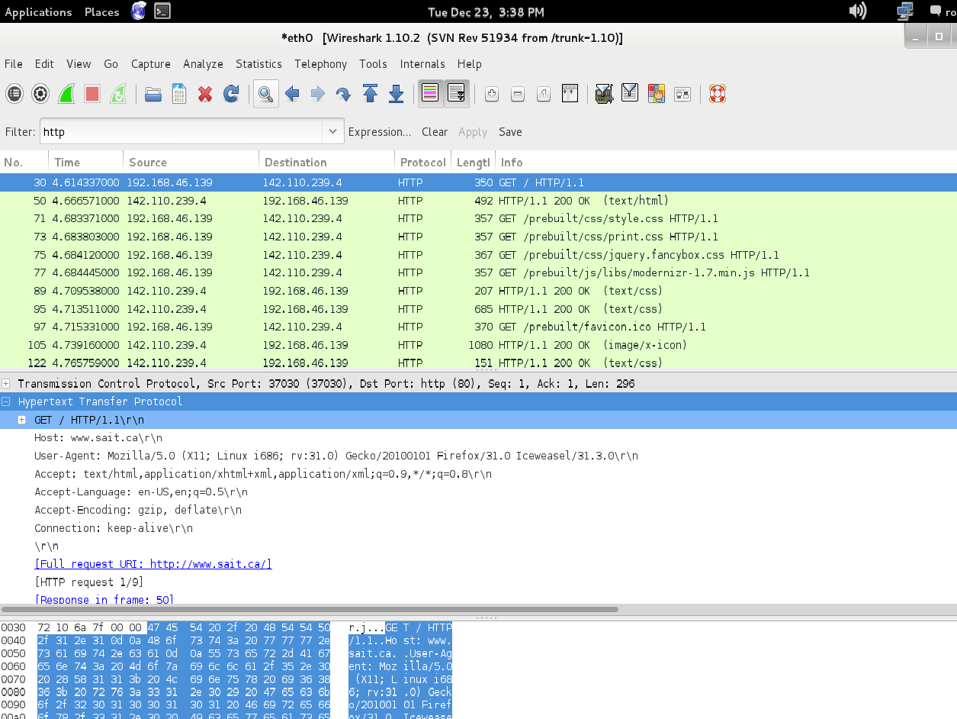
Wireshark: Capture Window
Shows the packets of various types that are being captured.
Stop the process when appropriate!
Show HTTP
packets only
Captured packets
Contents of selected
packet above

